Slide 1

COMPARATIVE ANALYSIS OF DEEP LEARNING MODELS FOR DENOISING HYPERSPECTRAL RAMAN SPECTROSCOPY IMAGE DATA IN BREAST CANCER RESEARCH
RESEARCH PROPOSAL
AKSHAY RAJ
31-07-2024
DUBLIN BUSINESS SCHOOL

Slide 2
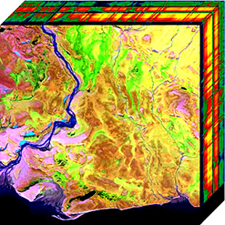
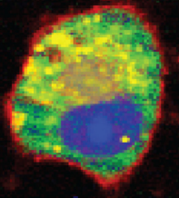
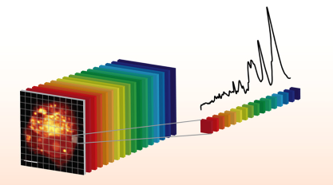
INTRODUCTION AND PROBLEM STATEMENT
Importance of Raman Spectroscopy in Breast Cancer Diagnostics
Provides non-destructive molecular imaging
High molecular contrast
The challenge: Weak Raman signals leading to noisy images
https://en.wikipedia.org/wiki/Hyperspectral_imaging
https://pubs.acs.org/doi/epdf/10.1021/acs.analchem.1c02178

Slide 3
MOTIVATION AND OBJECTIVE
Need for advanced denoising methods to enhance data quality
High noise levels reduce the interpretability of spectral data
Accurate molecular identification is critical for early cancer detection
Objective: Evaluate and compare deep learning models for denoising hyperspectral Raman images
Focus on Generative Adversarial Networks (GANs), Residual Attention Networks (RACN), and Denoising Autoencoders (DAEs)

Slide 4
METHODS AND LITERATURE REVIEW
Literature:
Key study: (Horgan et al. (2021) using 1D Residual U-Net) demonstrated effectiveness of deep learning models in denoising tasks
Methods:
Dataset: Hyperspectral Raman images of breast cancer cell samples
Algorithms: GANs, RACN, DAEs
Evaluation Metrics: Peak Signal-to-Noise Ratio (PSNR), Structural Similarity Index Measure (SSIM), Mean Squared Error (MSE)

Slide 5
EXPECTED RESULTS AND DISCUSSION
Expected outcomes:
Enhanced image quality
Comparative performance of the models
Improved signal-to-noise ratio (SNR)
Importance of these outcomes:
Better detection of molecular features
Contribution to reliable diagnostic tools

Slide 6
CONCLUSION AND IMPLICATIONS
Summary of research aims:
Compare deep learning models for denoising hyperspectral Raman images
Focus on enhancing image quality and interpretability
Potential impact on clinical applications:
More accurate diagnostics
Better treatment planning
Improved patient outcomes

Slide 7
THANK YOU

